Slide 1
Chatbot to respond to text queries pertaining to various Acts, Rules, and Regulations applicable to Mining industries
CSE7301 University Project
Review-3
Batch Number: CSE161
Roll Number | Student Name
20211CSE0869 | Mohammed Fouzan
20211CSE0802 | S. Owais Hussain
20211CSE0150 | Sufiyan Ahmed M
Under the Supervision of,
Dr. Ranjitha P
Assistant Professor
Presidency School of Computer Science and Engineering
Presidency University
Name of the Program: B.Tech
Name of the HoD: Dr. Asif Mohammed H.B
Name of the Program Project Coordinator: Dr. Ranjitha.P
Name of the School Project Coordinators: Dr. Sampath A K / Mr. Md Ziaur Rahman

Slide 2
Introduction
This chatbot is designed to assist users by providing instant responses to queries related to various Acts, Rules, and Regulations governing the mining industry, including DGMS Circulars and relevant compliance guidelines.
The main objective is to streamline access to legal and regulatory information, ensuring 24/7 support for mining professionals, stakeholders, and regulatory bodies, thereby enhancing compliance and operational efficiency.

Slide 3
Literature Review
Chatbots in Legal and Regulatory Domains Chatbots have been increasingly adopted in legal and compliance sectors to automate responses to frequently asked questions and reduce the burden on human experts. Studies like those by Surden (2019) emphasize how rule-based systems can effectively interpret structured legal data to provide accurate guidance.
Rule-Based Chatbots for Regulatory Information Rule-based chatbots are well-suited for structured domains like law, where clearly defined rules and keywords can guide response generation. According to Kalia et al. (2021), such bots use keyword-matching algorithms and pre-defined response templates to simulate domain-specific expertise effectively.

Slide 4
Literature Review
DGMS and Mining Regulations Digitization With the Directorate General of Mines Safety (DGMS) digitizing its circulars and compliance guidelines, there is scope to integrate such data into intelligent systems. Previous attempts have involved searchable databases, but not interactive chatbot systems that interpret user intent dynamically.
Gaps in Current Systems Most current legal information systems lack conversational interfaces, which makes them less user-friendly for quick queries. Literature suggests that incorporating chat-based access to regulatory content can significantly improve usability and accessibility, especially for on-site mining professionals.

Slide 5
Objectives
1.To develop a chatbot that can respond accurately to user queries related to various Acts, Rules, Regulations, and DGMS Circulars applicable to the mining industry.
2.To provide 24/7 automated assistance for stakeholders, improving accessibility to legal and regulatory information without the need for manual searching.
3.To implement a keyword-based, rule-driven system that ensures fast, reliable, and relevant answers based on predefined mining-related datasets.
4.To enhance compliance and awareness among mining professionals by simplifying access to complex legal content.
5.To minimize the dependency on legal experts for routine queries, thereby saving time and operational resources.

Slide 6
Existing method Drawback
Manual Search and Interpretation
Lack of Centralized Access
Limited Interactivity
No Instant Support
Not User-Friendly
Static and Non-Adaptive

Slide 7
Proposed Method
1. Rule-Based Keyword Matching System 2. Structured Database of Legal Documents 3. User Query Analysis 4. Interactive Response Generation 5. Feedback Loop for Improvement 6. User Interface

Slide 8
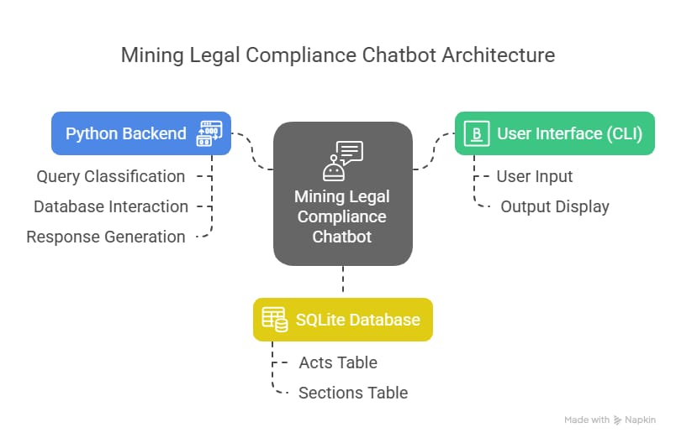
Architecture
The Mining Legal Compliance Chatbot is built on a modular architecture comprising three primary components:
User Interface (CLI): A command-line interface for input/output.
Python Backend: Handles query processing, database interactions, and response generation.
SQLite Database: Stores structured legal data.

Slide 9
Methodology
Requirement Analysis Identify the key Acts, Rules, DGMS Circulars, and regulatory documents relevant to the mining industry. Understand common user queries and information needs.
2. Data Collection and Structuring Collect and categorize legal content from verified sources. Structure the data into a searchable format suitable for rule-based access (e.g., categorized by topic or section).
3. Rule Design and Keyword Mapping Design a rule-based system by defining keyword sets and mapping them to specific legal responses. Create patterns for matching user queries to relevant sections.
4. Chatbot Development Develop the chatbot using a simple rule-based engine. Integrate the rule engine with the structured legal database and build the response mechanism.

Slide 10
Methodology
5. Interface Design Create a user-friendly chat interface (web or app) that allows users to input queries easily and receive responses in a clear format.
6. Testing and Validation Test the chatbot with sample queries to ensure accuracy, relevance, and responsiveness. Validate the system against real-world legal queries for correctness.
7. Deployment and Feedback Integration Deploy the chatbot for use. Include a feedback mechanism so users can report incorrect answers, which will help refine and expand the rule base over time.

Slide 11
software components
User Interface (UI): Chat interface implemented using web technologies (HTML/CSS/JavaScript) or mobile frameworks to facilitate user interaction.
Natural Language Processing (NLP) Module (optional): Basic NLP tools for query parsing and keyword extraction to improve understanding of user input.
Rule-Based Engine: Core logic that matches user queries with predefined keywords and rules to fetch relevant legal information.
Knowledge Base / Database: Structured storage of Acts, Rules, DGMS Circulars, and other mining-related regulations in a searchable format.
Response Generator: Formats the retrieved information into clear, user-friendly replies.
Feedback Module: Allows users to provide feedback on responses, supporting system improvement.
Backend Server: Hosts the chatbot application, processes queries, and manages data communication between components.

Slide 12
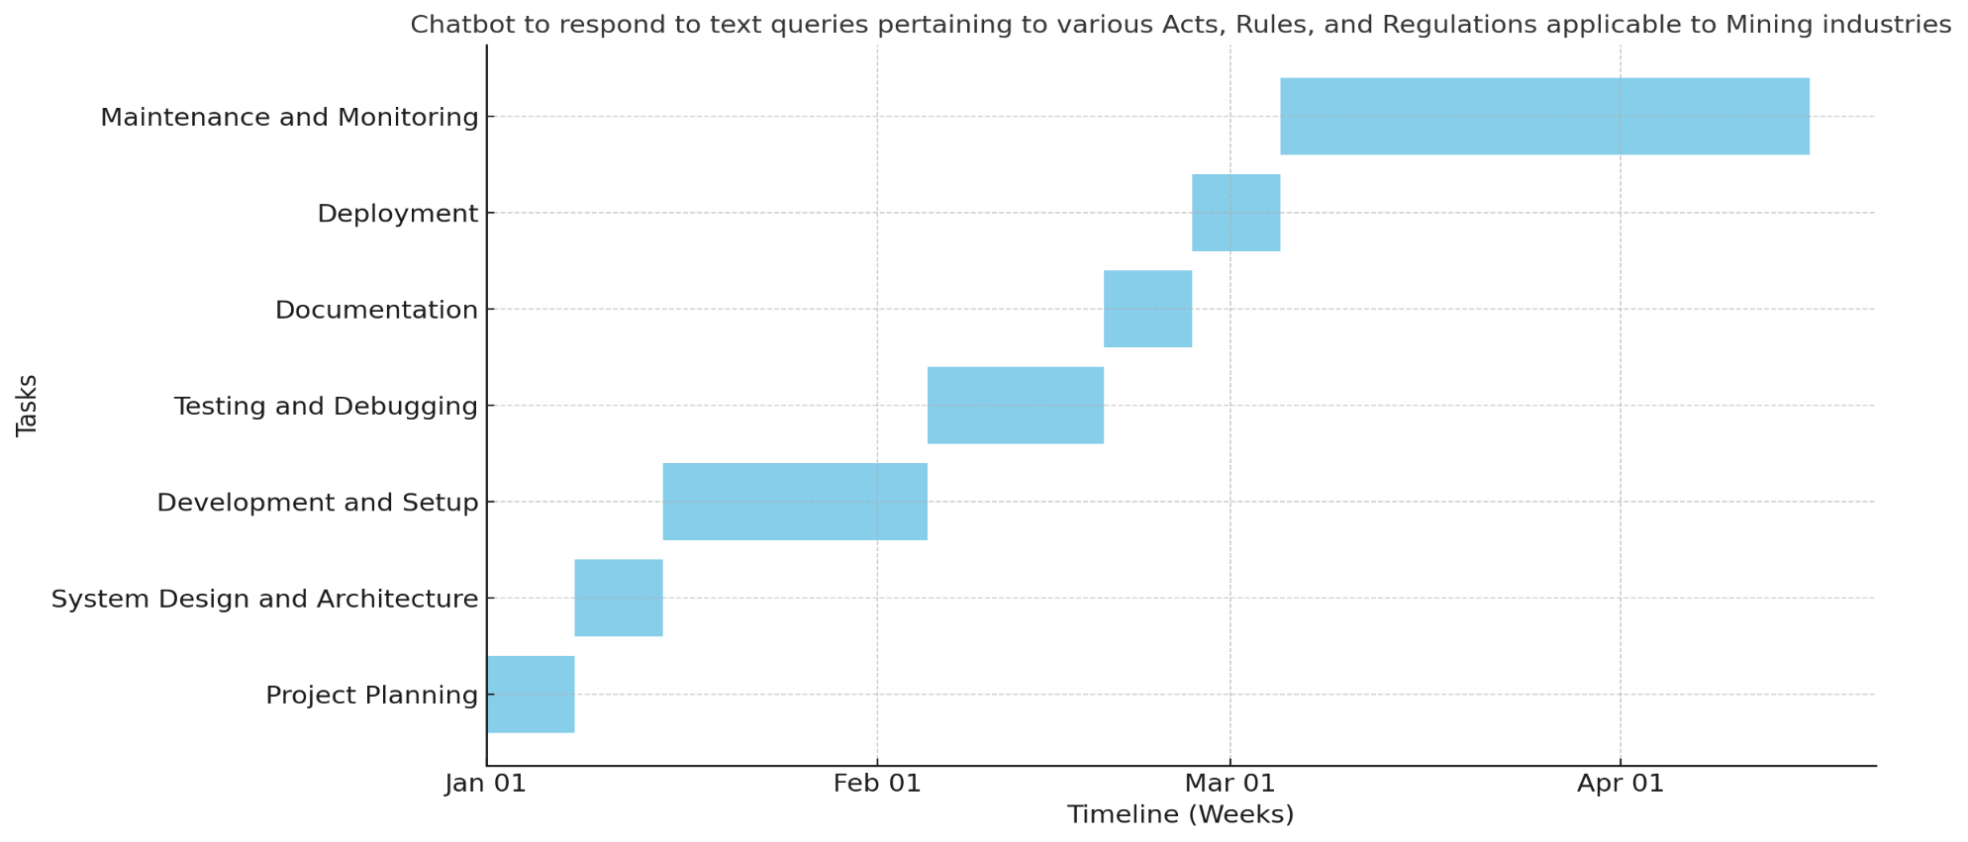
Timeline of Project

Slide 13
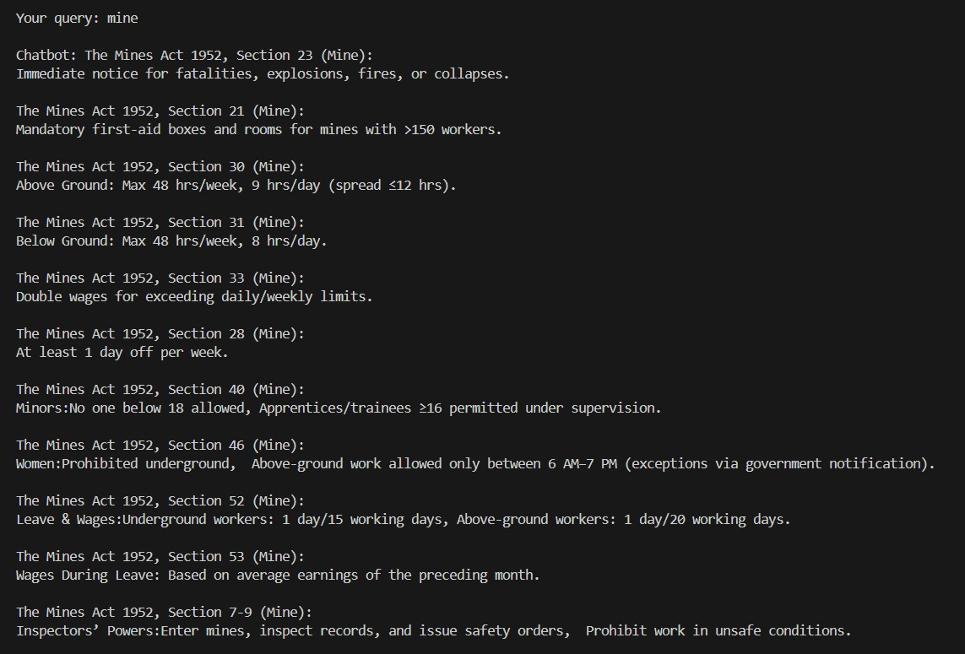
Expected Outcomes

Slide 14
Conclusion
The development of the chatbot designed to respond to text queries regarding various Acts, Rules, and Regulations applicable to the mining industry successfully demonstrates the potential of automated systems in enhancing access to legal and regulatory information. By providing timely, accurate, and easy-to-understand responses, the chatbot streamlines the process of retrieving important statutory details for stakeholders, including mining companies, regulatory authorities, and workers. This project highlights how technology can improve compliance, reduce the need for manual searches, and support informed decision-making within the mining sector. Future enhancements could include incorporating advanced natural language processing and machine learning to further improve the chatbot’s accuracy and ability to handle complex queries.

Slide 15
References
The Mines Act, 1952, Ministry of Labour and Employment, Government of India. [Online]. Available: https://labour.gov.in/acts/the-mines-act-1952
Directorate General of Mines Safety (DGMS), Ministry of Mines, Government of India. [Online]. Available: https://www.dgms.gov.in
Jain, A., & Singh, R. (2020). Applications of Chatbots in Legal and Regulatory Compliance. International Journal of Computer Applications, 175(7), 20-25.
Russell, S., & Norvig, P. (2021). Artificial Intelligence: A Modern Approach (4th ed.). Pearson.
Manning, C. D., & Schütze, H. (1999). Foundations of Statistical Natural Language Processing. MIT Press.
Python Software Foundation. Python Language Reference, version 3.10. Available at https://www.python.org
Mineral Conservation and Development Rules, 1988, Ministry of Mines, Government of India. [Online]. Available: https://mines.gov.in/writereaddata/Content/acts-rules/MCDR-1988.pdf

Slide 16
Project work mapping with SDG
This project aligns with Sustainable Development Goals (SDGs) by promoting SDG 8 (Decent Work) through mining safety regulations and worker welfare provisions, SDG 9 (Industry Innovation) by digitizing legal compliance for sustainable practices, SDG 13 (Climate Action) via environmental safeguards in mining laws, SDG 16 (Peace & Justice) by improving access to legal frameworks, and SDG 17 (Partnerships) through collaborative governance tools. It bridges legal compliance with sustainable development in mining sectors.

Slide 17
Thank You

